Slide 1


By Flavio Aguirre
23/04/2025

Slide 2

Outline
Executive Summary
Introduction
Methodology
Results
Conclusions

Slide 3
Executive Summary
This project aimed to estimate the economic viability of SpaceX launches by predicting the probability of a successful landing of the Falcon 9 first stage.
The dataset was provided by IBM, and the project followed all stages of the data science lifecycle: from data acquisition via the SpaceX API, through data cleaning and transformation (ETL), to exploratory data analysis and predictive modeling. The development was structured across eight interdependent notebooks.
The final model utilized the K-Nearest Neighbors algorithm and achieved an accuracy of 83%. Multiple influential factors in the landing success were identified, confirming that this outcome can be predicted based on measurable patterns. This approach demonstrates the real-world applicability of machine learning in the aerospace industry.

Slide 4
Introduction
SpaceX has revolutionized the aerospace industry with its reusable Falcon 9 launch system, reducing launch costs from over $165 million to approximately $62 million. This reusability offers a greater economic and technological advantage.
Predicting the landing success of the Falcon 9 first stage is essential for mission planning and cost estimating. It also provides valuable information for stakeholders in space logistics and investment.
This project seeks to build a machine learning model to predict landing outcomes using data provided by IBM and the SpaceX API. By applying the full data science workflow (data acquisition, processing, analysis, and modeling), we identify the key factors behind successful landings and offer a practical predictive tool for the aerospace industry.

Slide 5

Section 1

Slide 6
Methodology
Executive Summary
Data collection methodology:
Requests were made to the SpaceX API and web scraping was also used on Wikipedia.
Perform data wrangling
Pandas and Numpy were used for data management.
Perform exploratory data analysis (EDA) using visualization and SQL.
Perform interactive visual analytics using Folium and Plotly Dash.
Perform predictive analysis using classification models
Different classification models were implemented, giving KNN as the best algorithm with 83% accuracy.

Slide 7
Data Collection
The data for the following final project was collected using two different techniques. One was web scraping, which compiled historical Falcon 9 launch records from a Wikipedia page titled "List of Falcon 9 and Falcon Heavy launches."
Where we created a web archive of Falcon 9 launch logs with `BeautifulSoup` and extracted an HTML table of Falcon 9 launch logs from Wikipedia:
https://en.wikipedia.org/wiki/List_of_Falcon_9_and_Falcon_Heavy_launches
But the dataset we kept to follow the project was the one collected through the SpaceX API, through GET requests. We also performed some basic data manipulation and formatting operations.

Slide 8
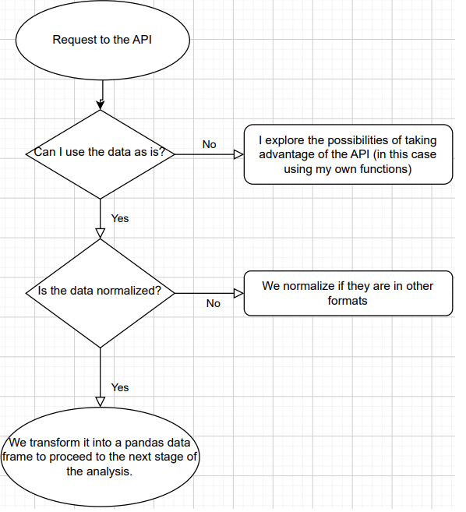
Data Collection – SpaceX API
In addition to using the request module, a series of auxiliary functions were defined that allowed the API to be used to extract information using ID numbers from the release data. The work was carried out as outlined in the following flowchart.
You can find the complete step-by-step extraction instructions at:
Link to the notebook

Slide 9
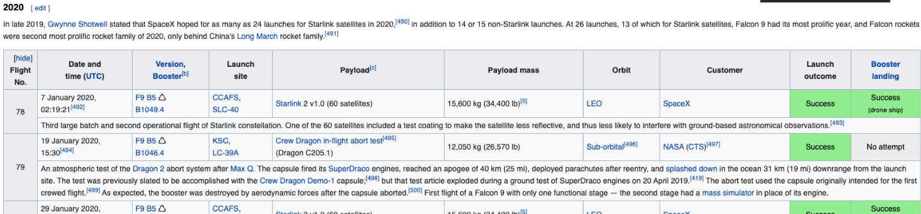
Data Collection - Scraping
In this project, we created a web archive of Falcon 9 launch logs using BeautifulSoup and extracted an HTML table from Wikipedia. The columns were then scraped using webscraping techniques to create a Pandas data frame. As shown here:
Link to the notebook

Slide 10
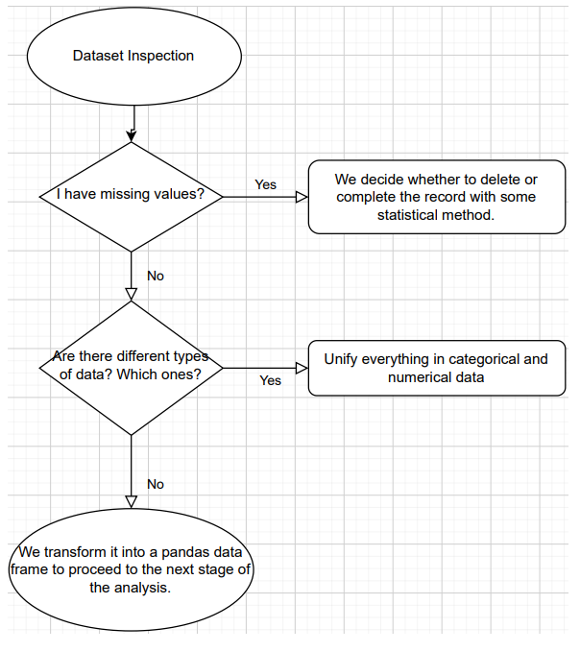
Data Wrangling
We analyzed the data to determine the type of data in the dataset and to see if we found any missing, duplicate, or null values. The following flowchart was followed.
You can also view the process at:
Link to the notebook

Slide 11
EDA with Data Visualization
For this approach, three types of graphs were used using pandas, matlplotlib, and seaborn:
Scatter plot: To visualize the relationship between two numerical variables.
Bar chart: To compare categorical values.
Line chart: To observe trends over time.
The full analysis and plots are available here:
Link to the notebook

Slide 12
EDA with SQL
The SPACEXTABLE table was created by filtering records with non-zero dates.
Unique launch sites (Launch_Site) were listed.
The payloads sent by NASA (CRS) were summed.
The average payload for F9 v1.1 was calculated.
The date of the first successful landing was obtained.
Successful and failed landings were counted.
The booster version with the largest payload was identified.
Pad landing failures during 2015 were listed with relevant details.
The complete and detailed process here:
Link to the notebook

Slide 13
Build an Interactive Map with Folium
The following Folium objects were used to build the map:
folium.Map: to create the interactive base map.
folium.Circle: to draw informative circles over specific locations.
folium.Marker: to visually mark the launch sites.
folium.MarkerCluster: to group nearby markers and reduce visual clutter.
MousePosition: to display real-time coordinates as the mouse moves over the map.
folium.DivIcon: to add custom-styled HTML/CSS text on the map.
folium.PolyLine: to draw lines connecting locations.
folium.FeatureGroup: to organize and manage related map elements together.
Consult:
Link to the notebook

Slide 14
Build a Dashboard with Plotly Dash
Components used in the Dash web application:
dcc.Dropdown: to select a launch site and display success vs. failure rates in a pie chart.
dcc.RangeSlider: to filter payload range and analyze its relation to success rate.
dcc.Graph: to render the pie and scatter plots.
Dash callbacks: enable dynamic interaction between interface elements.
The following graphics were used:
Pie Chart: shows the proportion of successful and failed launches by site.
Scatter Plot: illustrates the relationship between payload and launch outcome.
The complete process in:
Link to the notebook

Slide 15
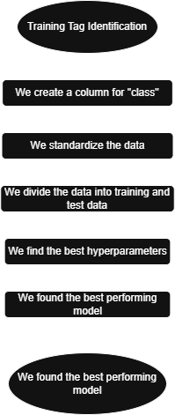
Predictive Analysis (Classification)
We performed exploratory data analysis and determined training labels.
We created a column for "class".
We standardized the data.
We split the data into training and test data.
We found the best hyperparameters for SVM, classification trees, and logistic regression.
We found the best performing method using test data.
The complete process in:
Link to the notebook

Slide 16
Results
Exploratory data analysis results:
- We were able to corroborate that there are certain parameters that directly influence the success or failure of any landing.
Interactive analysis demonstration in screenshots:
- We were able to visually determine how the launch site directly affects the success rate of any mission.
Predictive analysis results:
- A classification model (KNN) was developed with an accuracy of 83% for predicting the success of the first stage landing of SpaceX rockets.

Slide 17

Section 2

Slide 18
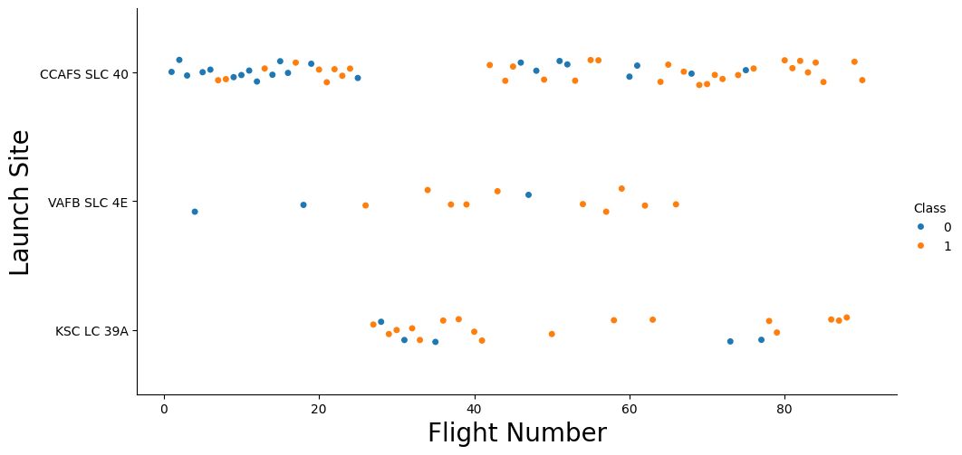
Flight Number vs. Launch Site
We see how as the flight number increases with respect to the launch site, the success rate of the missions at each launch site increases.

Slide 19
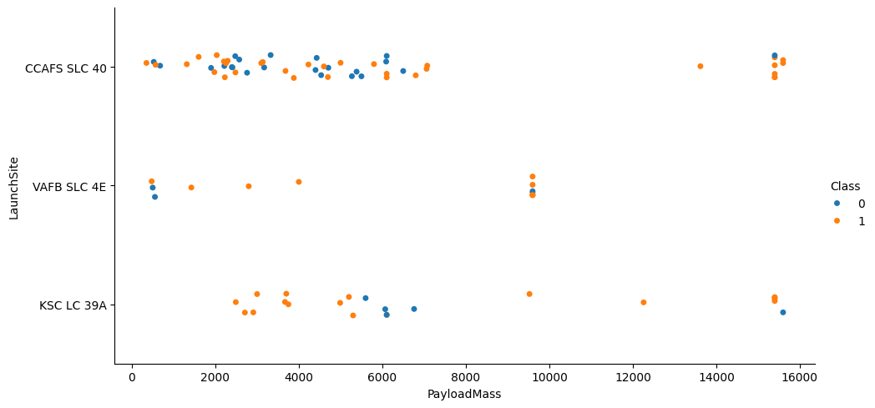
Payload vs. Launch Site
We can see that as the weight of the payload increases relative to the launch site, the number of successful missions increases.

Slide 20
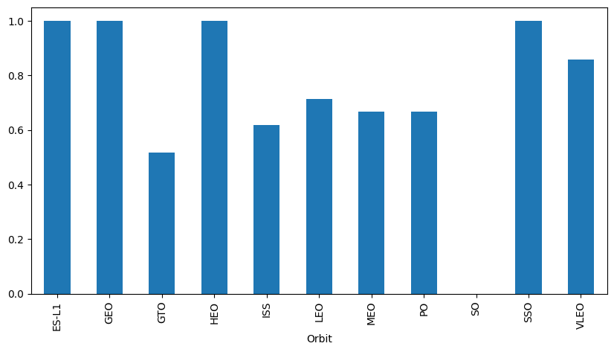
Success Rate vs. Orbit Type
It can be seen that depending on the orbit to which the mission leaves, its success rate increases considerably compared to the others.

Slide 21
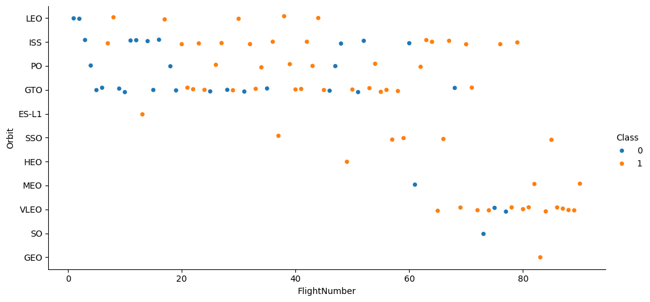
Flight Number vs. Orbit Type
We see how some orbits are much more common than others, and how some orbits seem to have a higher success rate. It's worth noting that as the flight number increases, the success rate of first-stage recovery increases.

Slide 22
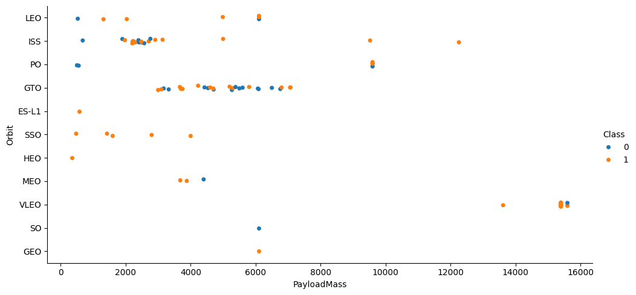
Payload vs. Orbit Type
We distinguish how the mass of the payload varies considerably depending on the orbit. But that in the same way the success rate remains considerable regardless of the weight of the payload, not so in all missions.

Slide 23
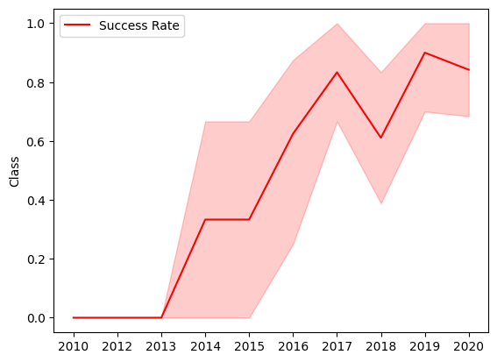
Launch Success Yearly Trend
This graph perfectly summarizes SpaceX's evolution toward success in rocket reusability:
-They went from 0% success rate in the early years to maintaining a rate above 85% from 2017 onward.
-It reflects progressive learning, technological consolidation, and continuous improvement.

Slide 24
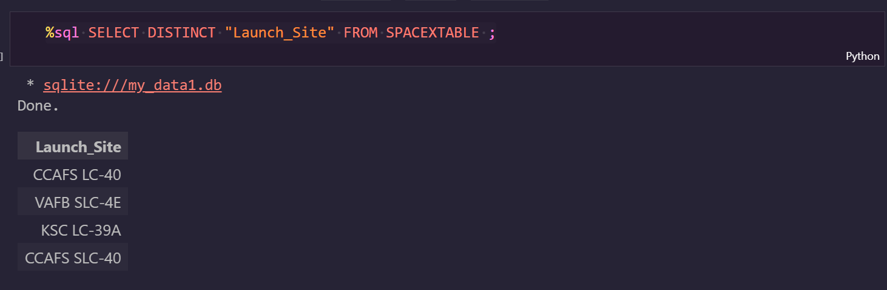
All Launch Site Names
With this SQL query we can visualize the 4 different launch locations that exist in our Database

Slide 25
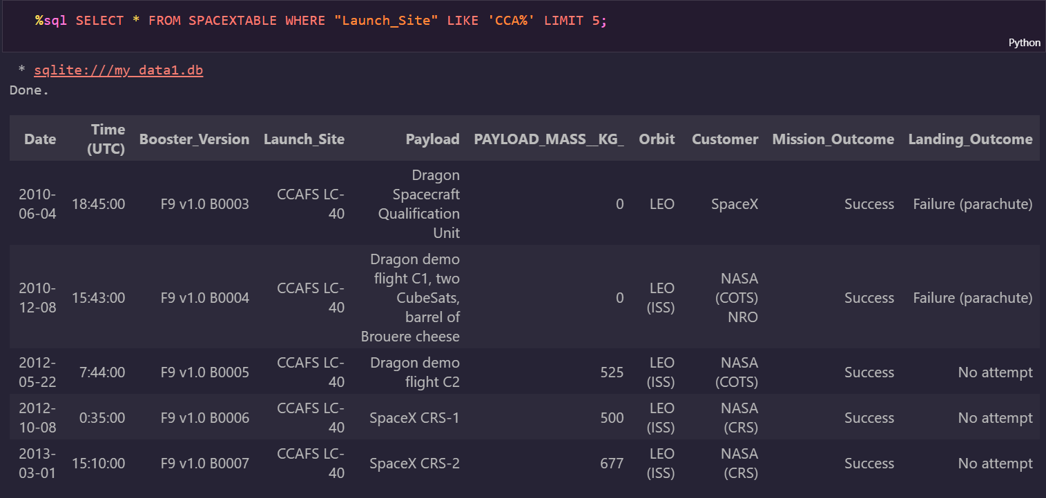
Launch Site Names Begin with 'CCA'
With this query we were able to see the first 5 records with launch site CCAFS LC-40

Slide 26
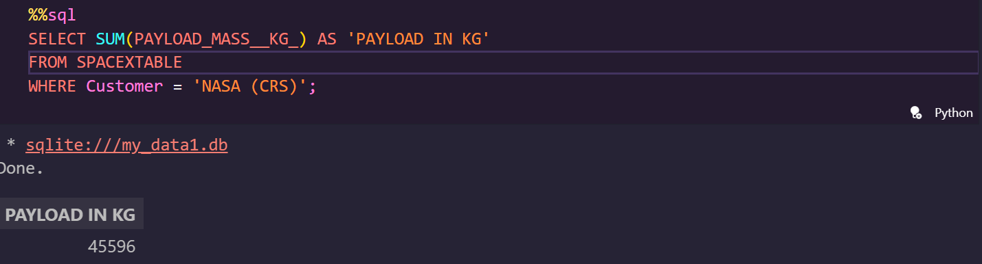
Total Payload Mass
The total weight of all payloads for all missions can be calculated using the SQL query shown in the image. The result is 45596 kg.

Slide 27
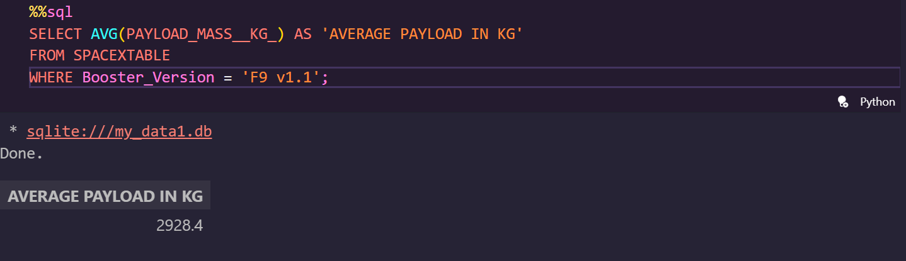
Average Payload Mass by F9 v1.1
We also see the average payload weight per launch through the SQL query, resulting in 2928.4 kg.

Slide 28
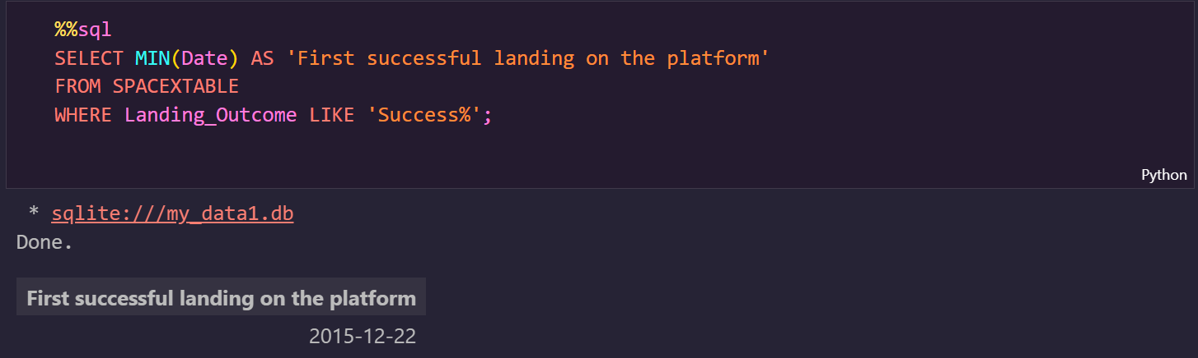
First Successful Ground Landing Date
We were able to identify the date of the first successful landing on the platform, as shown in the SQL query in the image. The result is December 22, 2015.

Slide 29
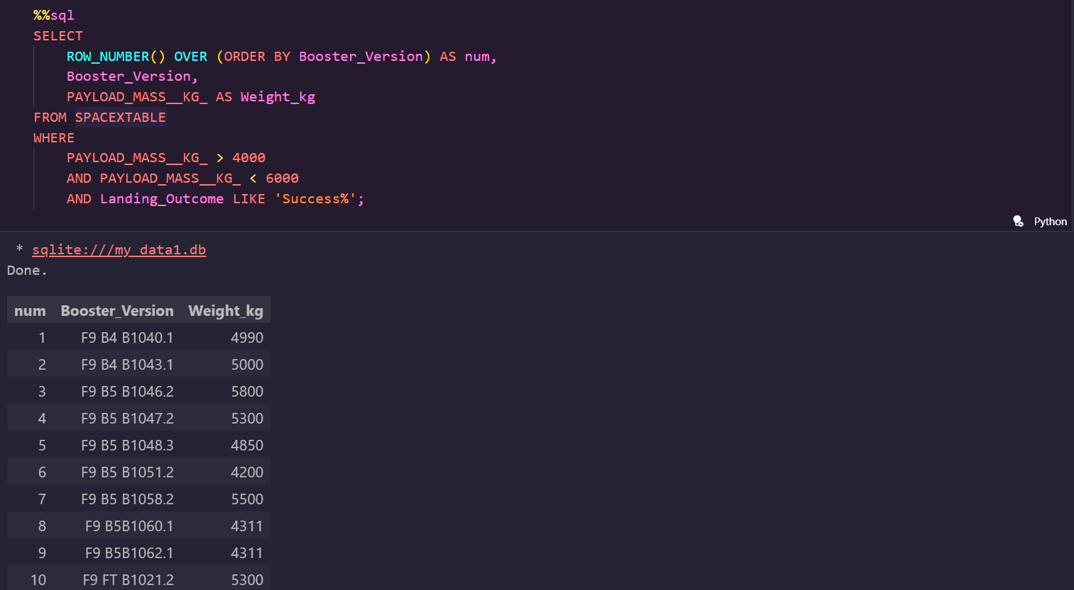
Successful Drone Ship Landing with Payload between 4000 and 6000
Thanks to this SQL query we can list all launches with a payload ranging from 4000 to 6000kg which have been successful.

Slide 30
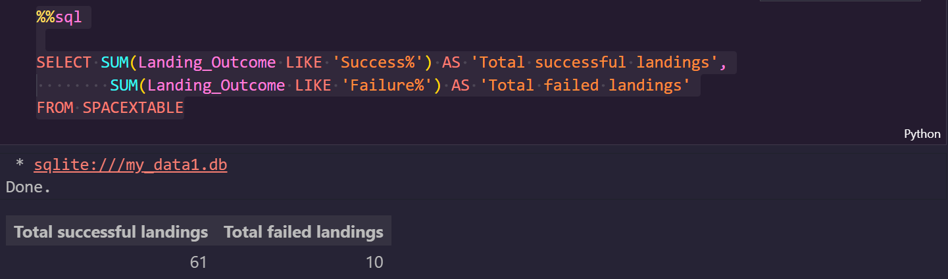
Total Number of Successful and Failure Mission Outcomes
As in the image query, we see that we have 61 successful launches vs 10 that were classified as failures.

Slide 31
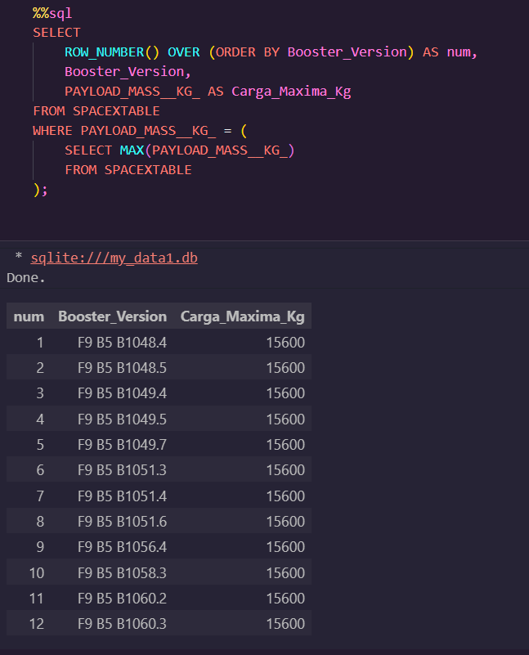
Boosters Carried Maximum Payload
As we see in the image below, with that SQL query we were able to list the 12 launches that have carried their maximum load.

Slide 32
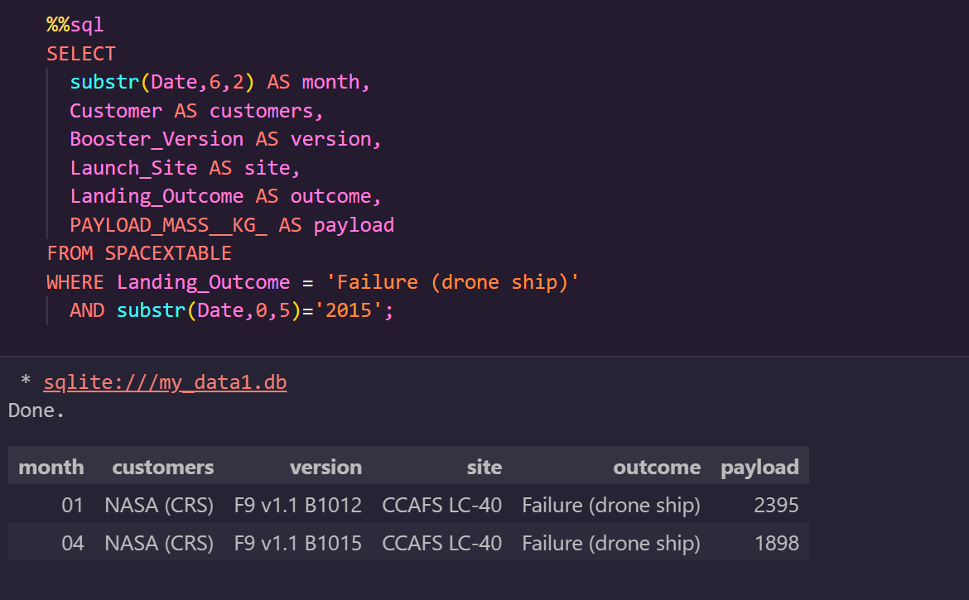
2015 Launch Records
It can be seen how only two missions were classified as failures this year, with a difference of 3 months and at the same launch site.

Slide 33
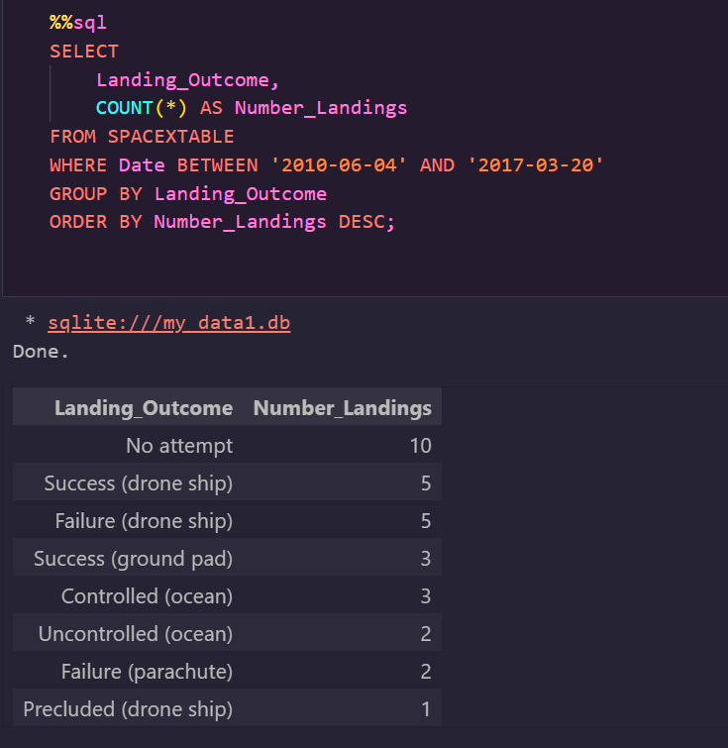
Rank Landing Outcomes Between 2010-06-04 and 2017-03-20
To conclude this analysis, we list the number of positive outcomes, sorting them by number of landing outcomes (such as failure (drone) or success (ground platform)) between June 4, 2010, and March 20, 2017, in descending order.

Slide 34

Section 3

Slide 35
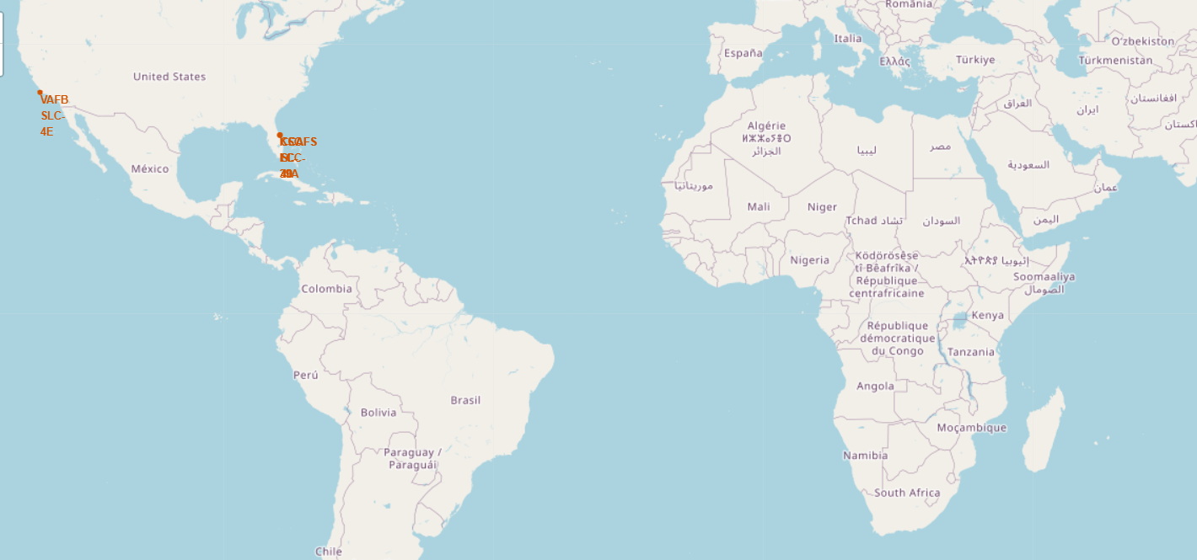
1- All launch sites with Folium

Slide 36
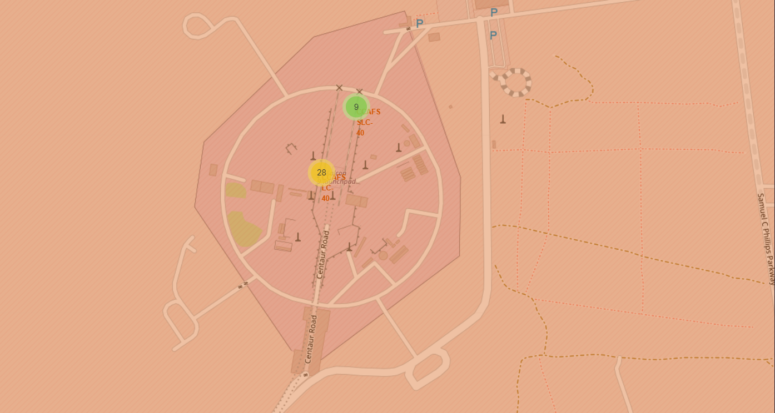
2- The launch results labeled by colors.

Slide 37
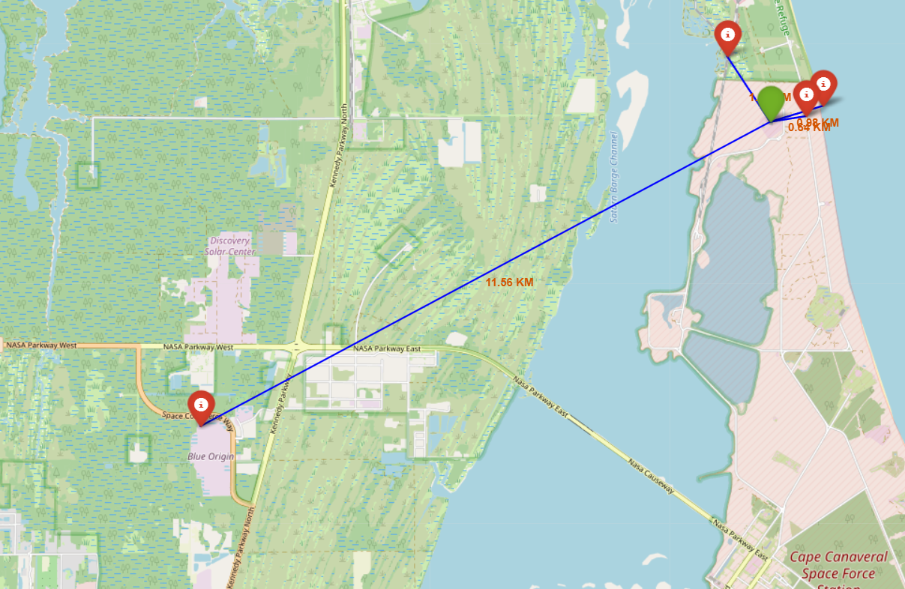
3- Launch location and distance to surrounding areas (cities, railways, etc.)

Slide 38
Analysis result
1- From the first image we can see the location of the launch sites on a global map.
2- The second image allows us to note, with colored labels, the number of successful launches in green, and the number of failed launches in orange, along with their respective locations.
3- We see that they are all close to the coasts and railways and far from cities and highways.
References:
Link to the notebook

Slide 39

Section 4

Slide 40
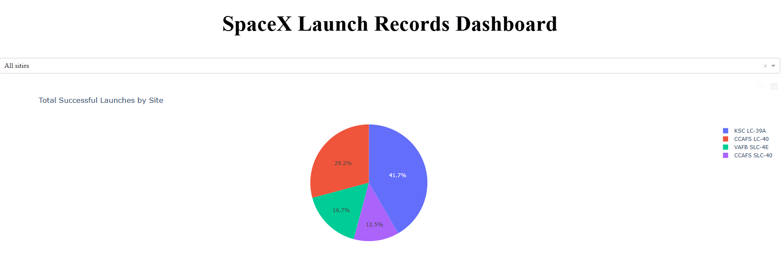
<Dashboard Screenshot 1>
We can see how the KSC LC-39A launch site has the highest success rate of 41.7% among all launches, while CCAFS SLC-40 has the worst success rate of 12.5%.

Slide 41
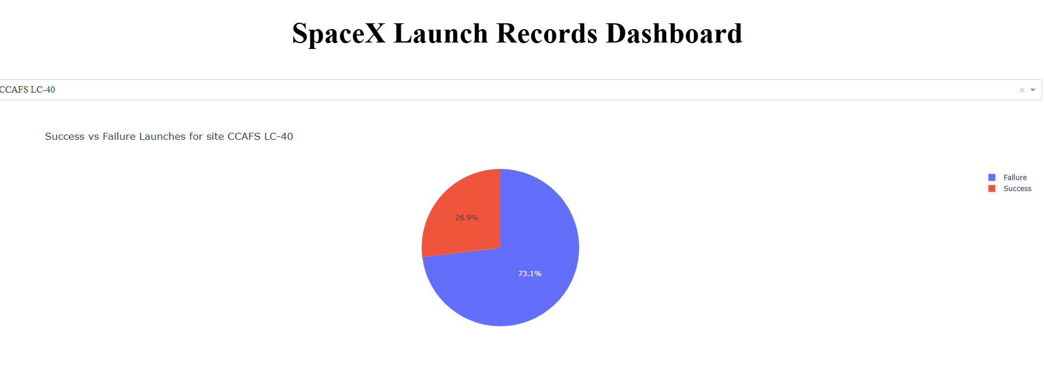
We see how CCAFS LC-40 has a high margin of more than 73% and only almost 26% of failures.

Slide 42
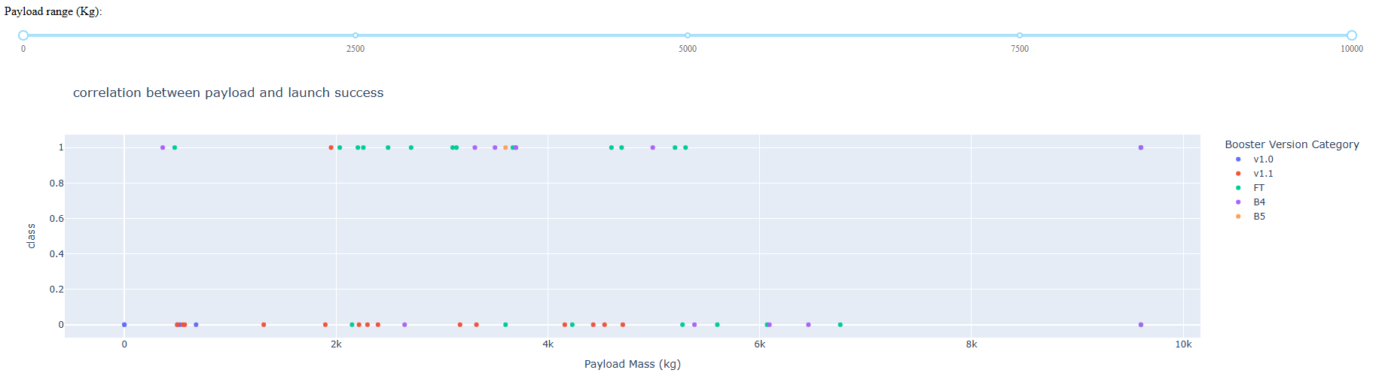
The graph doesn't show a clear relationship between weight and launch success. The "FT" and "B5" versions have more successes, while the "v1.0" and "v1.1" versions have more failures. Even payloads of up to 10,000 kg have been successfully launched.

Slide 43

Section 5

Slide 44
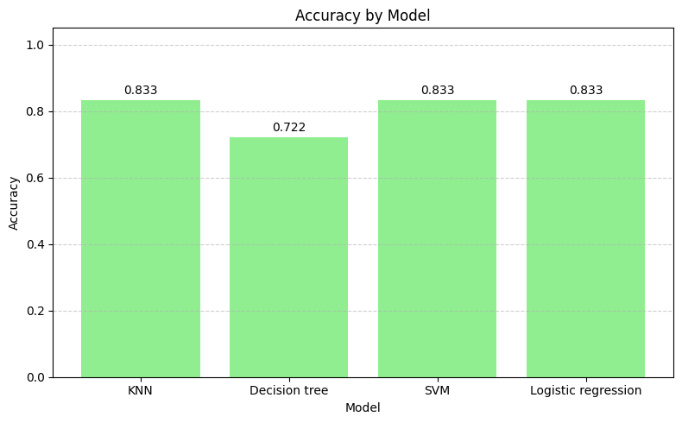
Classification Accuracy
We can see that there are no significant differences between the logistic regression, SVM, and KNN models, with all three models achieving a similar result of 83%. The decision tree performed the worst, with 72% accuracy.

Slide 45

Confusion Matrix
The model is very good at detecting those that do land (12/12 correct).
But it's quite confused about those that didn't land (12/12 correct).
It gets 3 right but 3 wrong.
It has perfect recall (it doesn't miss a single "landed").
But its accuracy isn't perfect, because it sometimes predicts "landed" when it actually didn't.

Slide 46
Conclusions
With 83% accuracy, the KNN model demonstrated that it is possible to predict the landing of reusable rockets with high reliability using measurable parameters and supervised machine learning techniques. Although this work is educational in nature, the results achieved reflect the enormous potential of applying artificial intelligence to real-world problems. This approach not only optimizes critical decisions but also anticipates a future where space exploration and automation advance hand in hand. This is just the beginning: data science doesn't predict the future, it builds it.

Slide 47


